Slide 1
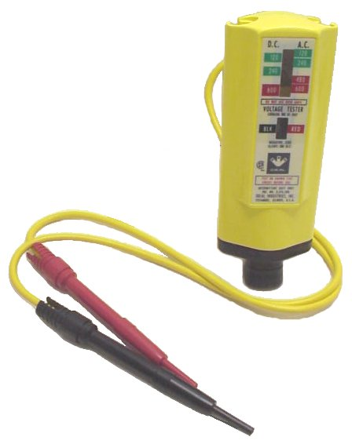
Voltage Tester
Used for testing voltage on electrical outlets, fuse clips, and circuit breakers will test voltage from 120 to 600 volts.
Notes:
Electrical-Electrical Tools Image: voltageTester.jpg Height: 566 Width: 448

Slide 2
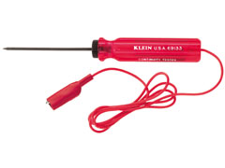
Continuity Tester
A device used to the continuity of a circuit.
Notes:
Electrical-Electrical Tools Image: ContinuityTester.jpg Height: 180 Width: 240

Slide 3
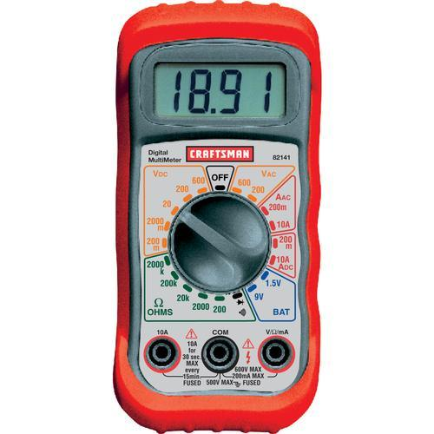
Multi-Tester or Volt-Ohm Meter
An analog or digital meter that commonly will measure AC volts, DC volts, Ohms, and milli-amps.
Notes:
Electrical-Electrical Tools Image: Digital multimeter.bmp Height: 300 Width: 300

Slide 4
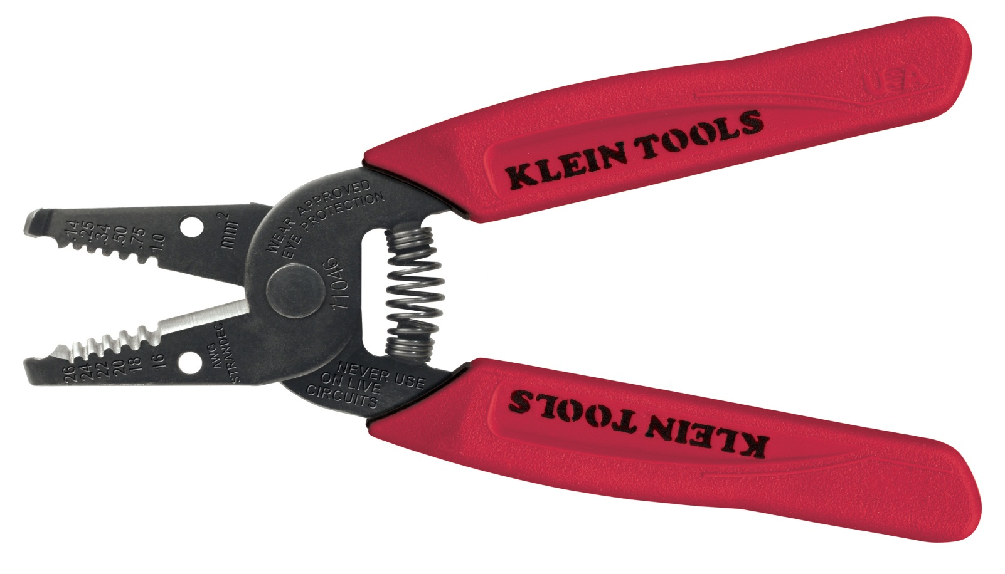
Wire Stripper
Used to strip plastic coating from solid electrical wires without damaging the wire .Can be adjusted to be used on various wire sizes.
Notes:
Electrical-Electrical Tools Image: Wire Stripper.jpg Height: 400.2546 Width: 700.3636

Slide 5
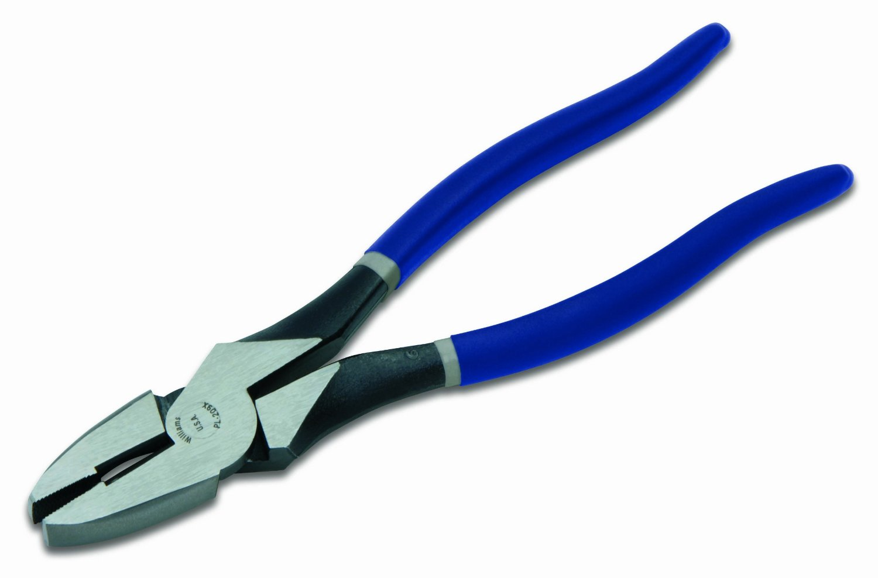
Lineman's Pliers
They are used on both bare and insulated wire. Note: These tools are also used for fence work and tying concrete rebar.
Notes:
Electrical-Electrical Tools Image: LinemansPliers.jpg Height: 592.8 Width: 900

Slide 6
NM Cable Cutter
A cutter for cutting Type NM cable.
Notes:
Electrical-Electrical Tools Image: NMCable Cutter.jpg Height: 99.84 Width: 464.16

Slide 7
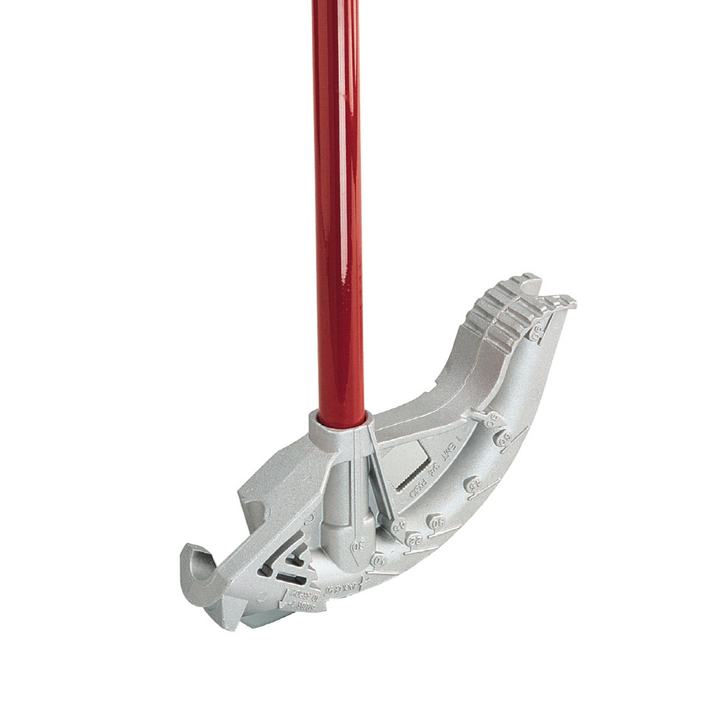
Conduit Bender
This enables an electrician to make accurate 45 and 90 degree bends. Bender may be designated for EMT or rigid conduit.
Notes:
Electrical-Electrical Tools Image: EMTBender.jpg Height: 900 Width: 900

Slide 8
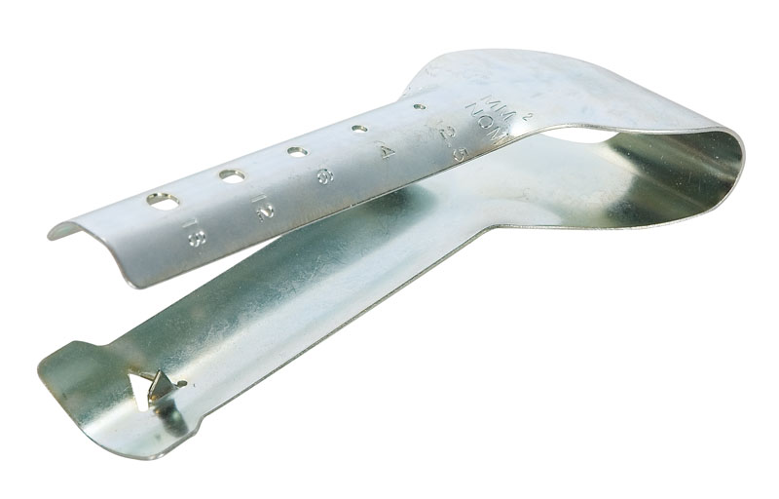
Non-Metallic Cable Ripper
Made of a thin “U” shaped metal piece.
Notes:
Electrical-Electrical Tools Image: CableRipper.JPG Height: 512 Width: 800

Slide 9
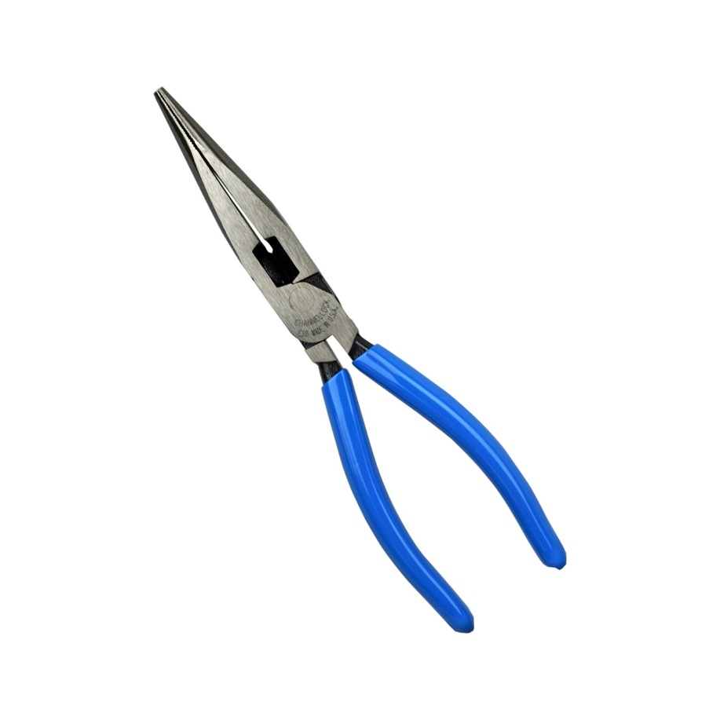
Long Nose Pliers
Also used for stripping wire, making eyes in wire and holding wire in place while inserting screws.
Notes:
Electrical-Electrical Tools Image: NeedleNosePliers.jpg Height: 900 Width: 900

Slide 10
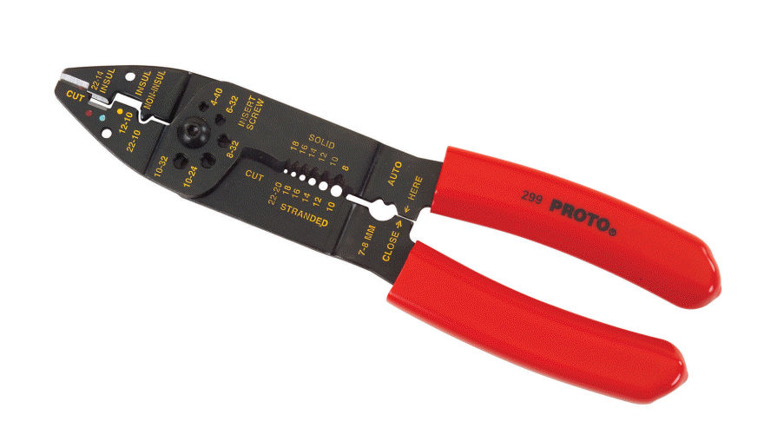
Wire Stripper And Crimping Tool
Used for stripping wire, cutting wire and crimping wire terminals on stripped wire ends.
Notes:
Electrical-Electrical Tools Image: CrimpTool.jpg Height: 514.2858 Width: 890.8887

Slide 11
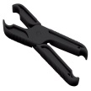
Fuse Puller
Made of plastic to prevent electrician from being shocked while installing or removing fuses.
Notes:
Electrical-Electrical Tools Image: FusePuller.jpg Height: 561.6 Width: 900

Slide 12
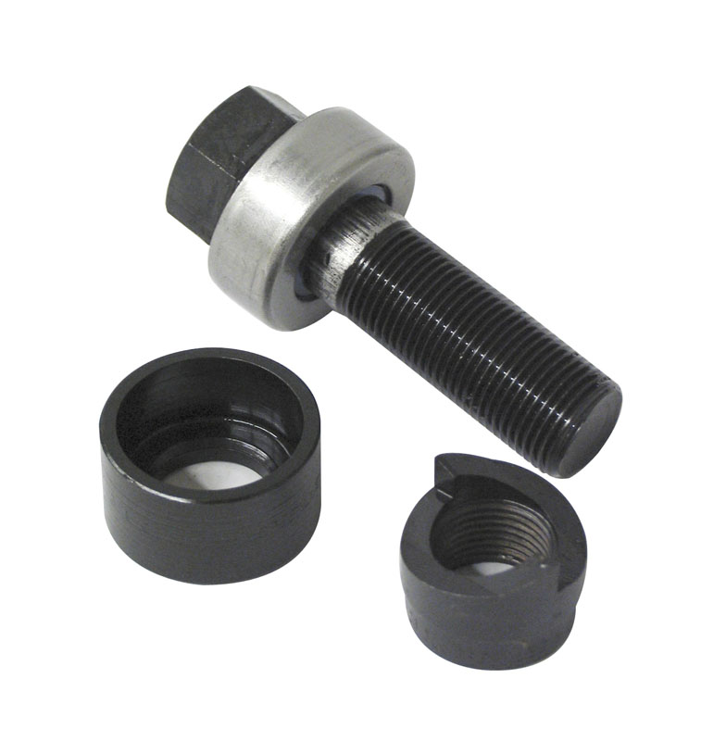
Knockout Punch
Sizes range from 1/2 to 2 1/2 inches. Used to create a hole in panel for connecting conduit.
Notes:
Electrical-Electrical Tools Image: greenlee_punch.jpg Height: 800 Width: 784

Slide 13
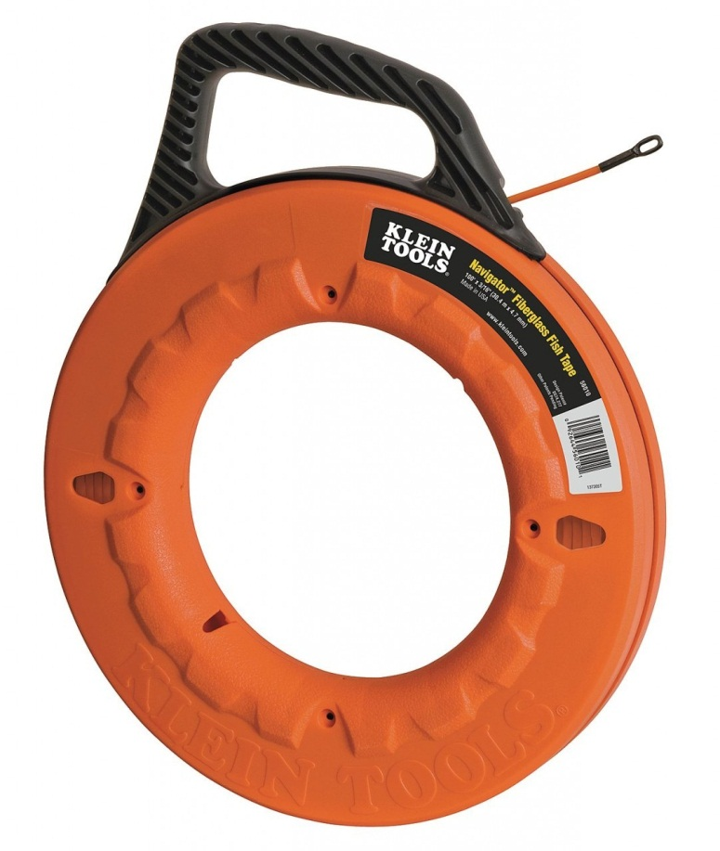
Fish Tape
Fish tapes come in 25, 50 and 100 foot lengths.
Notes:
Electrical-Electrical Tools Image: FishTape.jpg Height: 1280 Width: 1082

Slide 14
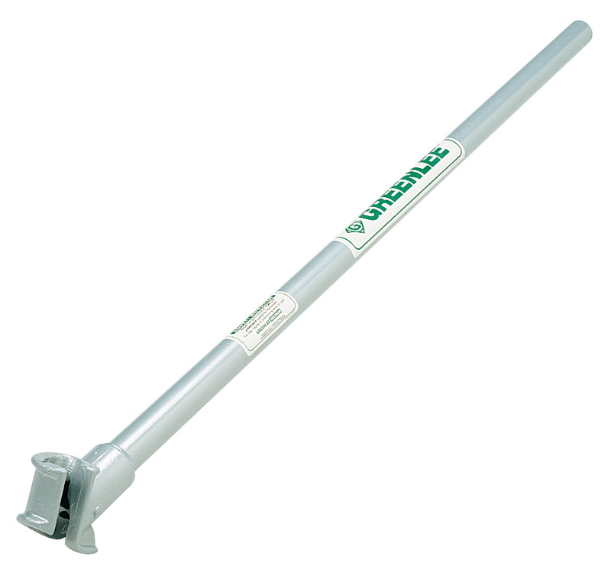
Hickey
The Hickey or bender is used for short radius bends.
Notes:
Electrical-Electrical Tools Image: Hickey.jpg Height: 763.3296 Width: 809.8988

Slide 15
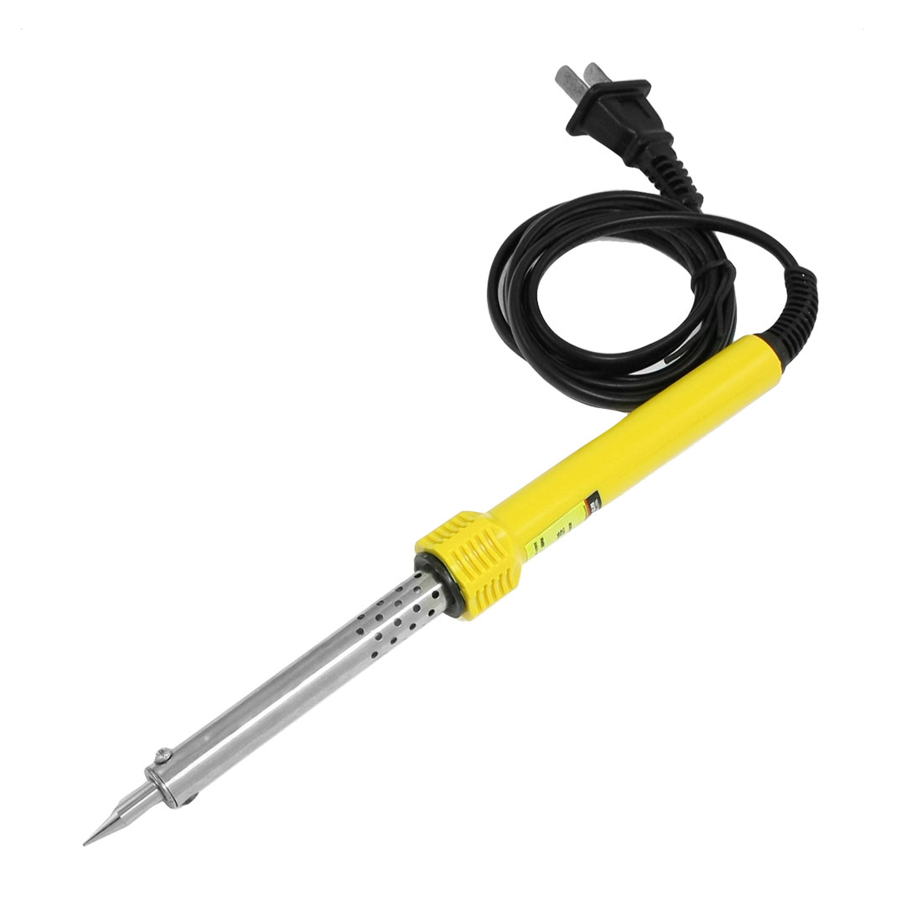
Electric Soldering Iron
It has a replaceable copper tip. Soldering irons are sized from very light duty for soldering fine wires to heavy duty for soldering sheet metal.
Notes:
Electrical-Electrical Tools Image: SolderingIron.jpg Height: 660 Width: 660

Slide 16
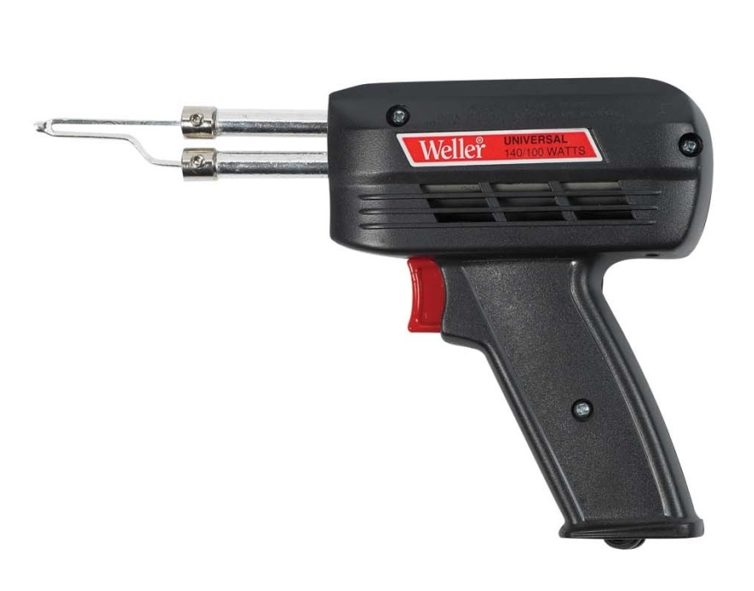
Soldering Gun
It is fitted with a replaceable tip and operates on 115-volt AC. Used primarily for soldering wires.
Notes:
Electrical-Electrical Tools Image: SolderingGun.jpg Height: 689 Width: 879

Slide 17
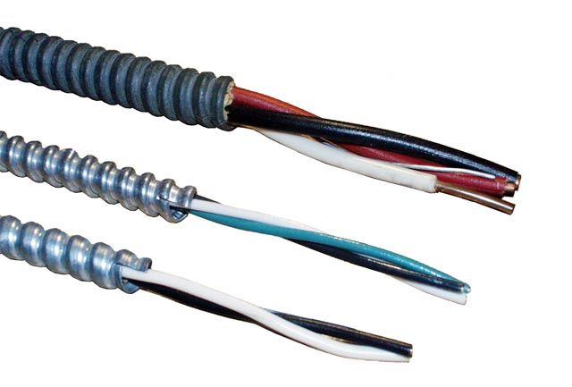
Armored Cable
This cable must run from box to box without splices.
Notes:
Electrical-Electrical Supplies Image: ArmoredCable.jpg Height: 259.8 Width: 384

Slide 18
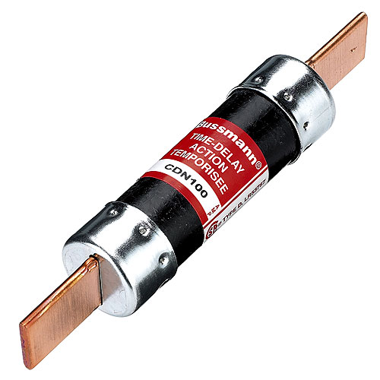
Knife Fuse
The knife fuse is made in several sizes for service of 60 to 600 amps and is not interchangeable with cartridge fuses or knife fuses of different capacities.
Notes:
Electrical-Electrical Supplies Image: KnifeFuse.jpg Height: 300 Width: 300

Slide 19
Circuit Breaker
Used to protect the wire in a circuit. Rated in amps.
Notes:
Electrical-Electrical Supplies Image: CurcuitBreaker.jpg Height: 660 Width: 660

Slide 20
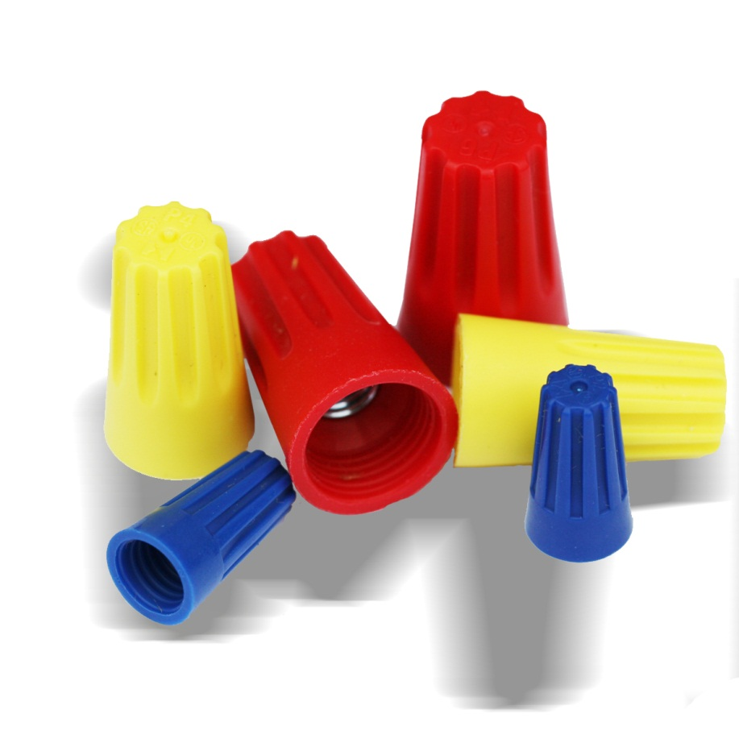
Wire Nut
Used to connect AC wires. Color coded to denote capacity.
Notes:
Electrical-Electrical Supplies Image: Wire Nuts.jpg Height: 288 Width: 288

Slide 21
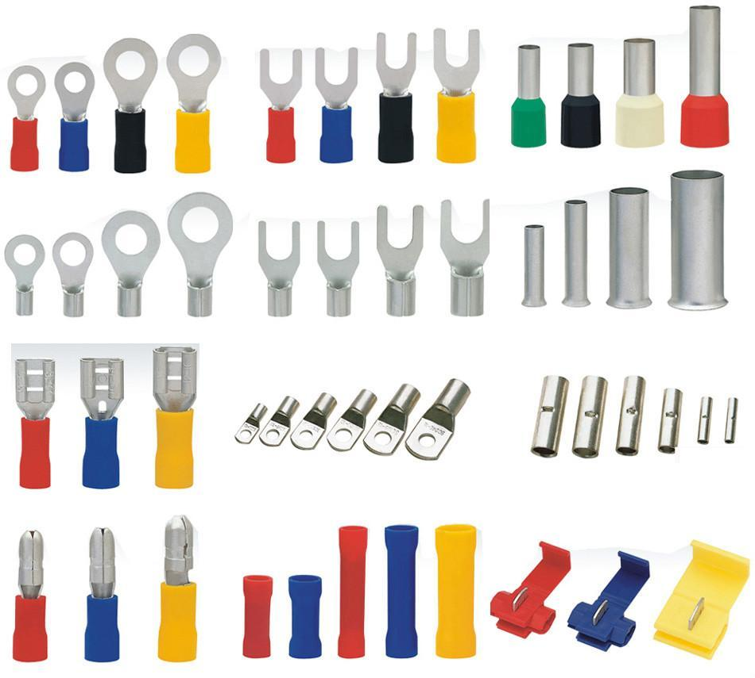
Solderless Connector
Used where a permanent connection is desired. Connectors can be insulated or un-insulated. Commonly used for wiring on mobile equipment.
Notes:
Electrical-Electrical Supplies Image: SolderlessConnector.jpg Height: 513 Width: 570

Slide 22
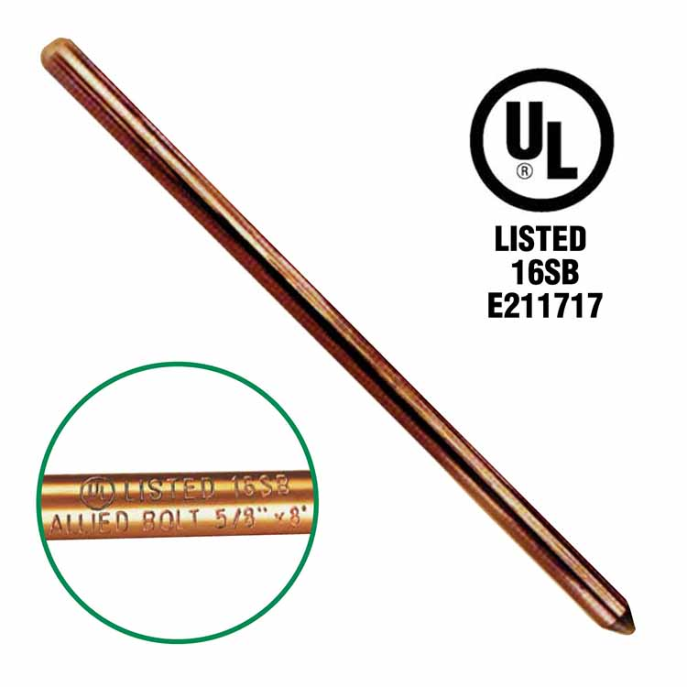
Ground Rod
It is connected to the electrical service box or meter can by a shielded ground wire and a ground clamp.
Notes:
Electrical-Electrical Supplies Image: GroundRod.jpg Height: 180 Width: 180

Slide 23
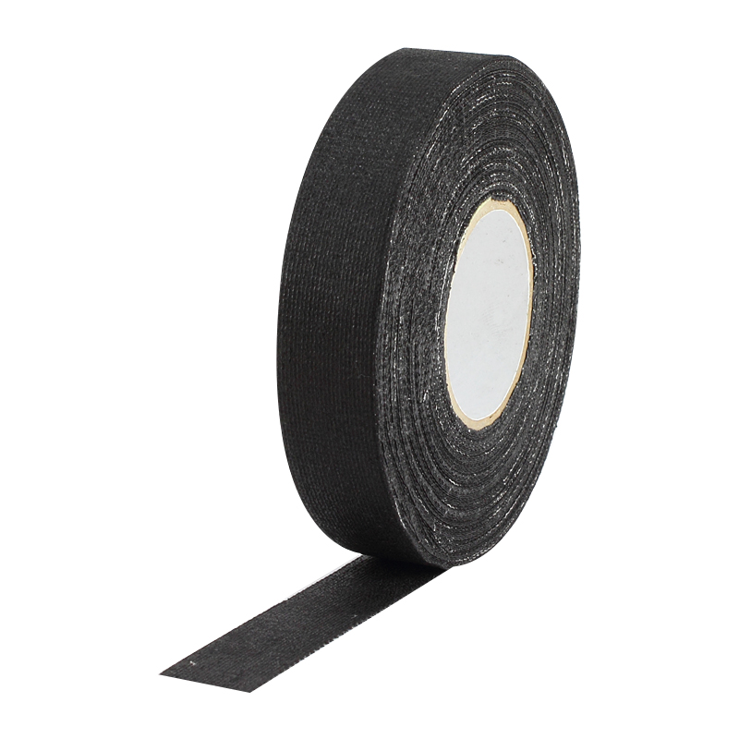
Friction Tape
Used over rubber insulating tape on wire Splices and is used to replace the outer braid.
Notes:
Electrical-Electrical Supplies Image: FrictionTape.jpg Height: 480 Width: 480

Slide 24
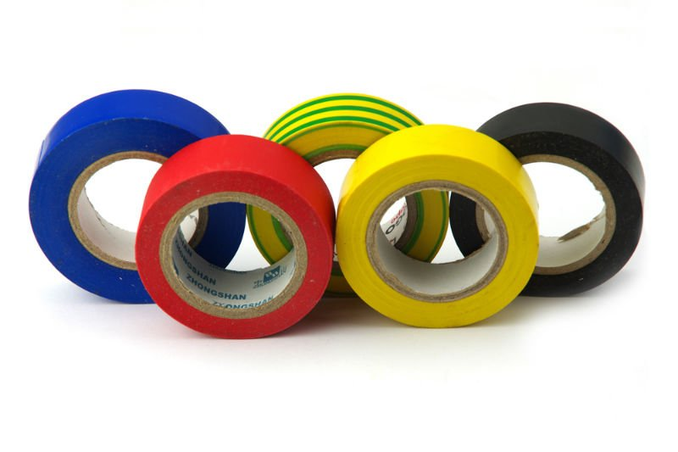
Plastic Tape
It is used alone without friction tape.
Notes:
Electrical-Electrical Supplies Image: ElectricalTape.jpg Height: 319.8 Width: 480

Slide 25
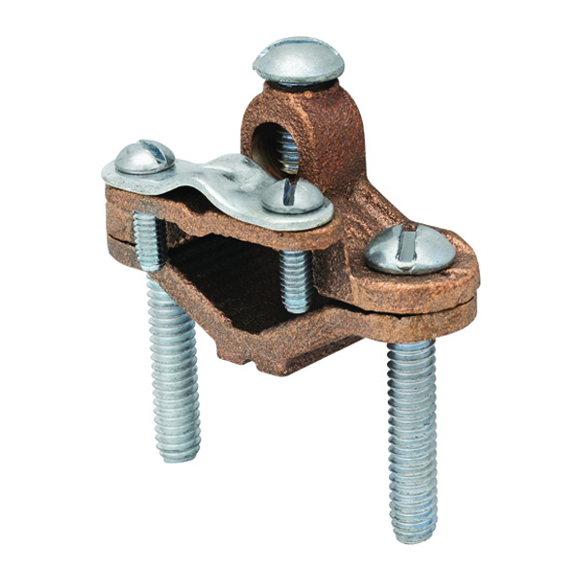
Ground Rod Clamp
Connects a ground wire to a grounding rod, reinforcing bar, or metal water pipe. This provides for a good ground in the event of a power spike or lightning strike.
Notes:
Electrical-Electrical Supplies Image: GroundClamp.jpg Height: 144 Width: 144

Slide 26
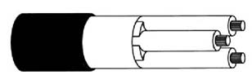
Electric Cord
A flexible cable used for extension cords and connecting power tools. May be plastic (e.g. Type xx) or rubber covered (e.g.. Type SJ)
Notes:
Electrical-Electrical Supplies Image: SJCable.jpg Height: 103 Width: 308

Slide 27
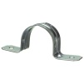
Conduit Straps
Conduit is placed in the curved portion and strap is secured by nails or screws. Single foot and double foot styles. Sized for EMT and rigid/PVC conduit.
Notes:
Electrical-Electrical Supplies Image: ConduitStrap.jpg Height: 750 Width: 750

Slide 28
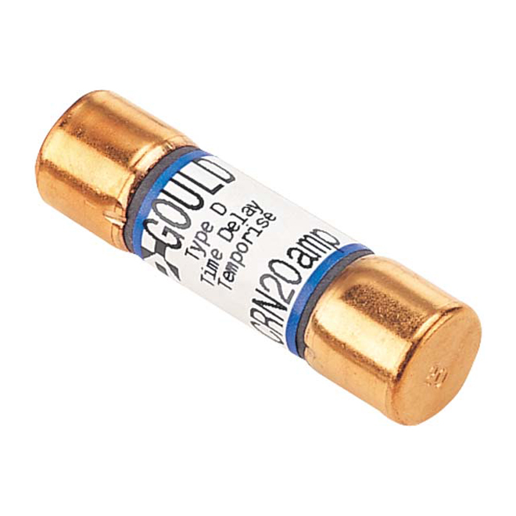
Cartridge Fuse
It is a cylinder shaped like a cartridge case and has metal ferrules at each end and a soft fusible element inside.
Notes:
Electrical-Electrical Supplies Image: CartFuse.jpg Height: 668.1666 Width: 668.1666

Slide 29
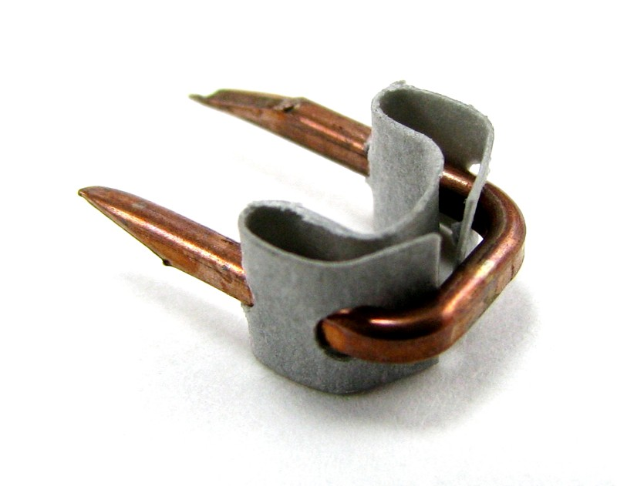
Insulated Staple
Commonly used for low voltage wire used in applications such as door bells or sprinkler controllers. It should not be used 120-volt lines.
Notes:
Electrical-Electrical Supplies Image: InsulatedStaple.jpg Height: 252.4 Width: 320

Slide 30
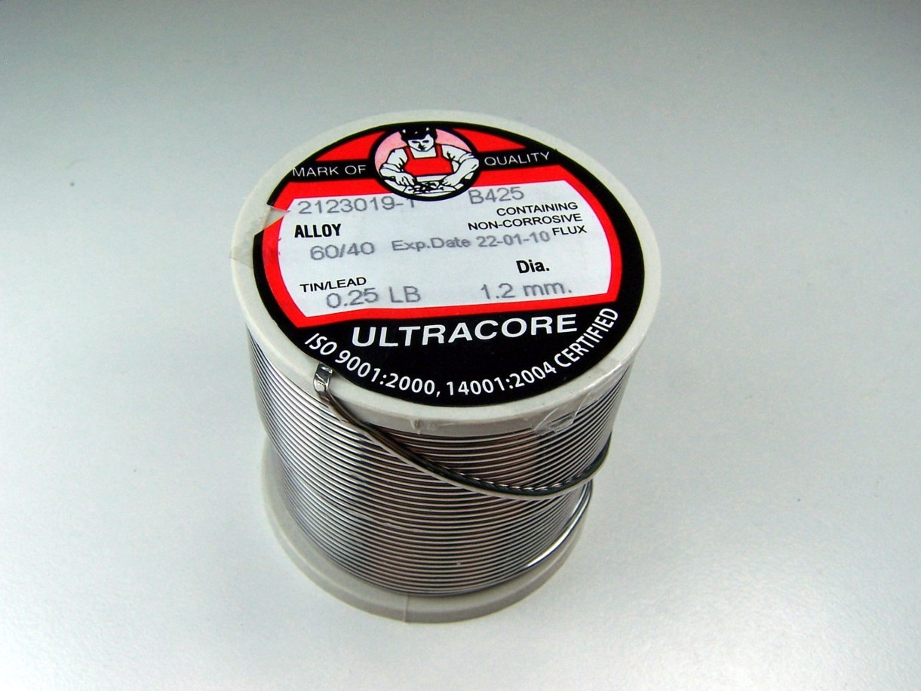
Core Solder
It is available in spools. Rosin core is used to solder wires and acid core to solder sheet metal.
Notes:
Electrical-Electrical Supplies Image: CoreSolder.jpg Height: 1728 Width: 2304

Slide 31
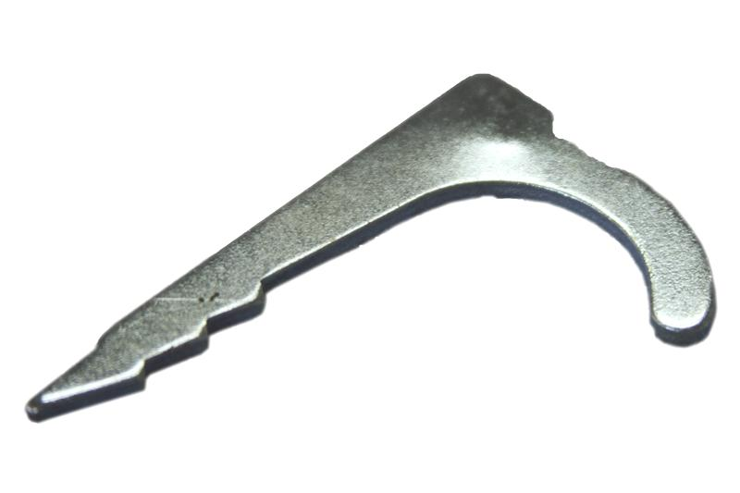
Conduit Drive Strap
Made of die cast zinc, it is driven into wood with a hammer with conduit resting in curved end.
Notes:
Electrical-Electrical Supplies Image: StrapNailDrive.jpg Height: 533 Width: 800

Slide 32
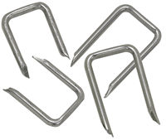
Non-metallic Cable Staples
Staples used to secure type NM cable to wood.
Notes:
Electrical-Electrical Supplies Image: NM_Staples.jpg Height: 169 Width: 200

Slide 33
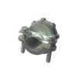
Non-Metallic Clamp
The cable is secured by means of a bracket tightened with screws. Used to secure a NM cable to a box.
Notes:
Electrical-Electrical Supplies Image: NMCableClamp.jpg Height: 1000 Width: 1000

Slide 34
UF Cable
A solid plastic covering is used on this cable making it suitable for direct burial of the cable. UF cable is sized like NM cable.
Notes:
Electrical-Electrical Supplies Image: UFCable.jpg Height: 77 Width: 325

Slide 35
Single Conductor
A single conductor with thermal plastic insulation. Wire may be solid or stranded. Typical types are TW and THHN. Common sizes 14-0
Notes:
Electrical-Electrical Supplies Image: THHN.jpg Height: 79 Width: 303

Slide 36
Non-Metallic Cable
A cable with a plastic cover used for residential indoor wiring. Commonly found with 3 and 4 conductor in sizes 14-6. For example "14-2 w/ ground" will have 3 14 gauge conductors, 1 black, one white, and one bare.
Notes:
Electrical-Electrical Supplies Image: NMCable.jpg Height: 75 Width: 324

Slide 37
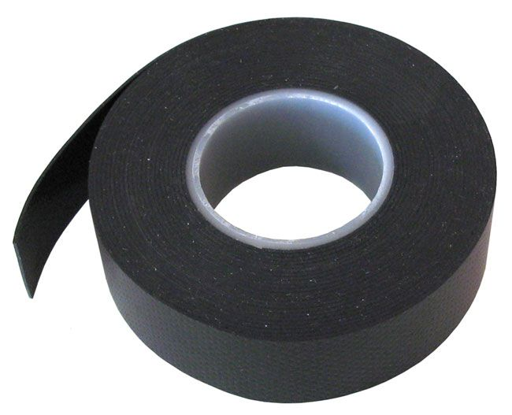
Rubber Tape
Used on high voltage connections. It is covered with friction tape or plastic tape.
Notes:
Electrical-Electrical Supplies Image: RubberTape.jpg Height: 316.2 Width: 390

Slide 38
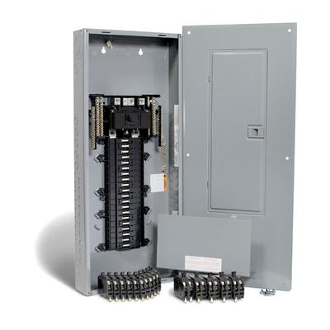
Service Entrance Panel (SEP)
Used to distribute power in a building. Contains a main disconnect and circuit breakers.
Notes:
Electrical-Electrical Supplies Image: ServicePanel.jpg Height: 192 Width: 192

Slide 39
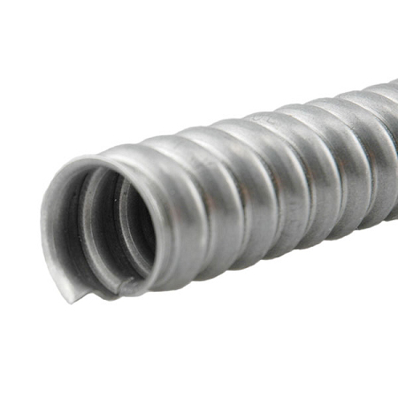
Flexible Conduit
It consists of a heavily zinc coated steel strip wound spiraling, with interlocked construction permitting greater flexibility.
Notes:
Electrical-EMT & Flex Conduit Image: FlexConduit.jpg Height: 270 Width: 270

Slide 40
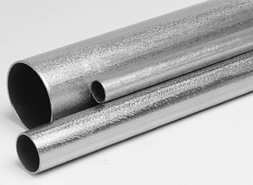
Electrical Metallic Tubing
A thin walled conduit. Commonly abbreviated as EMT. It is coupled with special fittings and is smooth inside. Manufactured in 10 foot lengths. Common sizes 1/2"-2". Approved for indoor use.
Notes:
Electrical-EMT & Flex Conduit Image: EMT.jpg Height: 205 Width: 280

Slide 41
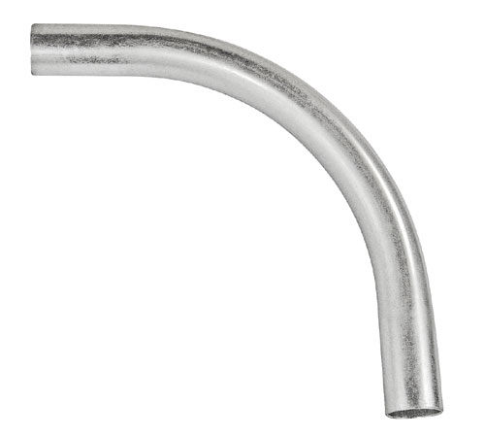
EMT Sweep
The difference being, it is made of thin wall conduit and has no threads.
Notes:
Electrical-EMT & Flex Conduit Image: EMT_Sweep.jpg Height: 269.4 Width: 300

Slide 42
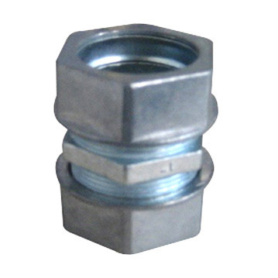
EMT Coupling
A compression fitting used to join EMT conduit.
Notes:
Electrical-EMT & Flex Conduit Image: EMTCoupling.jpg Height: 258.48 Width: 258.48

Slide 43
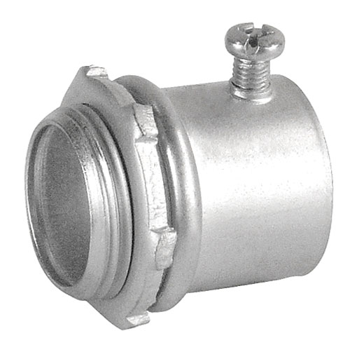
EMT Connector
Used to connect EMT conduit to a box, panel, or other threaded fitting.
Notes:
Electrical-EMT & Flex Conduit Image: EMTConnector.jpg Height: 301.2 Width: 300

Slide 44
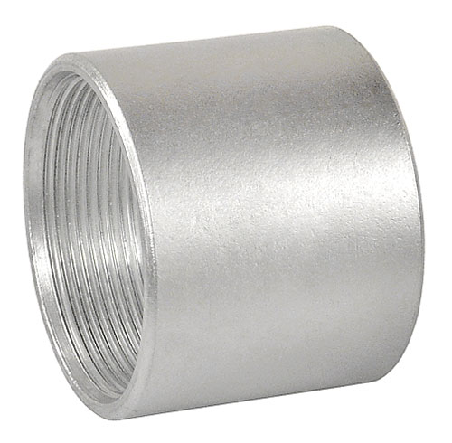
Ridged Coupling
Made of galvanized steel.
Notes:
Electrical-Rigid Conduit Image: RigidCoupling.jpg Height: 294 Width: 300

Slide 45
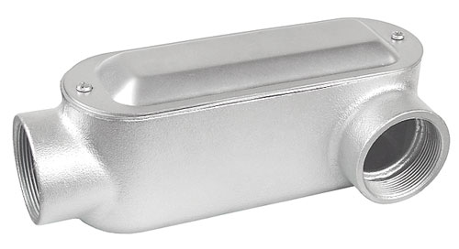
Ridged Entrance Ell
Has female thread on each end and has removable cap for access to wire for splicing or pulling.
Notes:
Electrical-Rigid Conduit Image: RigidEntranceLB.jpg Height: 163.2 Width: 300

Slide 46
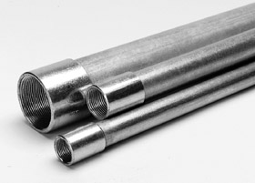
Ridged Conduit
It is available in galvanized and enamel finishes.
Notes:
Electrical-Rigid Conduit Image: RigidConduit.jpg Height: 201 Width: 280

Slide 47
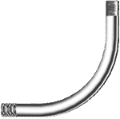
Ridged Elbow or Sweep
Sizes range from 1/2 to 2 inch. Threaded on both ends.
Notes:
Electrical-Rigid Conduit Image: RigidConduitSweep.gif Height: 89.4 Width: 90

Slide 48
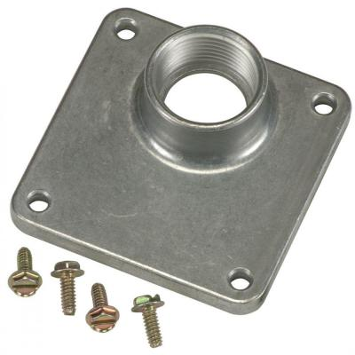
Raintite Hub
Made of cast aluminum and has a flange with pre-drilled holes for mounting to panel, and threaded inlet for conduit.
Notes:
Electrical-Rigid Conduit Image: Raintight Hub.jpg Height: 400 Width: 400

Slide 49
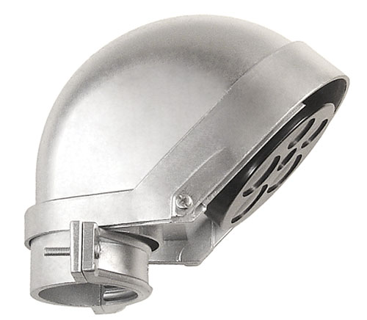
Service Entrance Cap
Made of cast aluminum or PVC.
Notes:
Electrical-Rigid Conduit Image: ServiceEntranceCap.jpg Height: 261.6 Width: 300

Slide 50
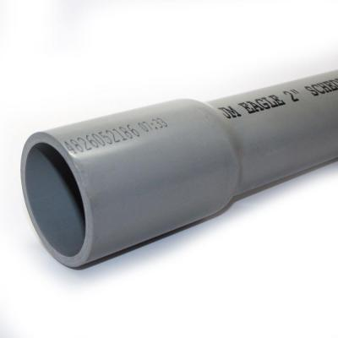
PVC Conduit
PVC conduit is used inside, outside or underground. Gray in color. Glued connections make it waterproof.
Notes:
Electrical-PCV Conduit Image: PVC_Conduit.jpg Height: 400 Width: 400

Slide 51
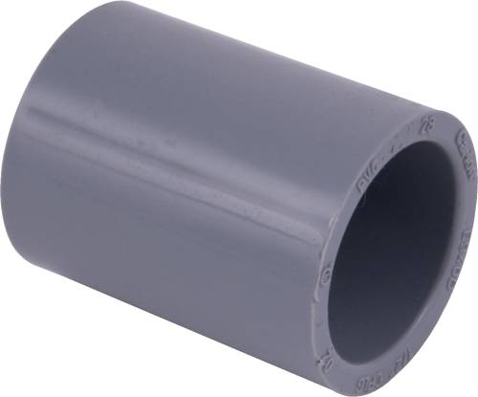
PVC Conduit Coupling
Used to connect PVC conduit, must be glued and once connected cannot be removed.
Notes:
Electrical-PCV Conduit Image: PVCCoupling.jpg Height: 249 Width: 300

Slide 52
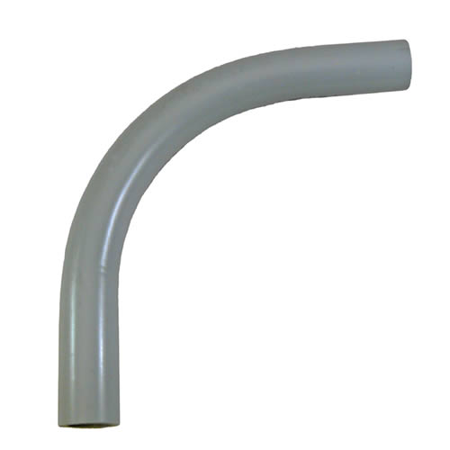
PVC Elbow or Sweep
It has a long radius and is connected by gluing couplings on elbow and pipe.
Notes:
Electrical-PCV Conduit Image: PVC90Sweep.jpg Height: 500 Width: 500

Slide 53
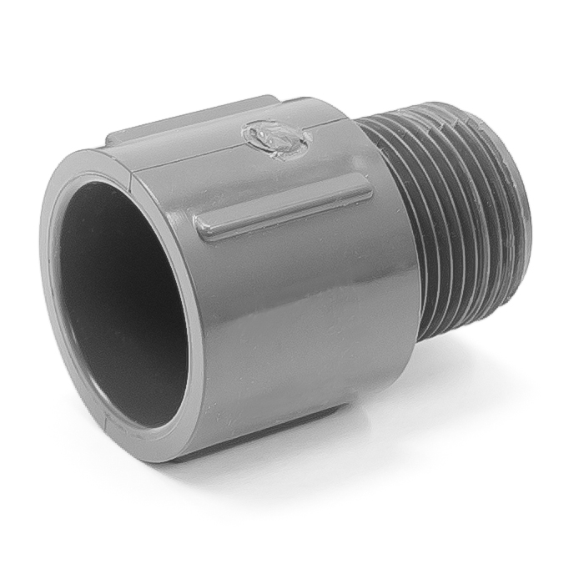
PVC Conduit Male Adaptor
Adapts PVC conduit to a threaded fitting for connecting to a box, panel , etc.
Notes:
Electrical-PCV Conduit Image: PVCMA.jpg Height: 420 Width: 420

Slide 54
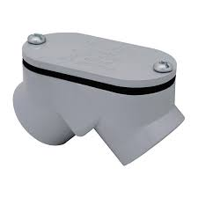
PVC Pull Elbow
Used to make 90 degree bends and has removable cap for splicing or pulling wire. Glues to PVC conduit. Types denote the location of the cover (e.g. LB, LR)
Notes:
Electrical-PCV Conduit Image: PVCPullEll.jpg Height: 135 Width: 135

Slide 55
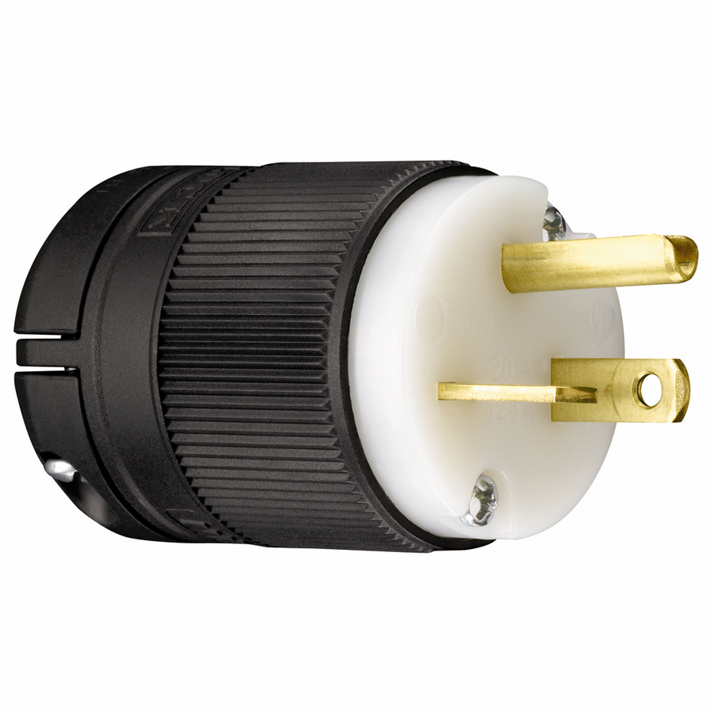
Cord Cap
It is some times called a male plug. Used on extension cords and power tool cords.
Notes:
Electrical-Boxes and Devices Image: CordCap.jpg Height: 900 Width: 900

Slide 56
Cord Connectors
This connecting body is designed to accommodate the cord cap and is sometimes called a female plug.
Notes:
Electrical-Boxes and Devices Image: Cord Connector.jpg Height: 900 Width: 900

Slide 57
Lampholder
A plastic or porcelain device that holds a lamp.
Notes:
Electrical-Boxes and Devices Image: LampHolder.jpg Height: 900 Width: 900

Slide 58
Duplex Receptacle
Receptacles may be installed in outlet boxes flush with the wall or in surface mounted boxes or junction boxes.
Notes:
Electrical-Boxes and Devices Image: DuplexRecpt.jpg Height: 900 Width: 900

Slide 59
Switch Box
Comes with knockouts for non-metallic sheathed cable or electrical metallic tubing. Boxes must be covered either with a cover or a fixture.
Notes:
Electrical-Boxes and Devices Image: HandyBox.jpg Height: 430.2 Width: 300

Slide 60
Plastic Box
Commonly constructed of PVC plastic and used with NM cable. May be attached with nails (shown) or screws. Comes in 1 -4 gang sizes and varying depths.
Notes:
Electrical-Boxes and Devices Image: Plastic box.jpg Height: 1000 Width: 1000

Slide 61
Junction Box
Usually made of metal in square or octagon shaped boxes. Boxes must be covered either with a cover or a fixture.
Notes:
Electrical-Boxes and Devices Image: JctBox.jpg Height: 311.4 Width: 300

Slide 62
Box Cover
Used to cover a device such as a switch or DR. May configurations are available.
Notes:
Electrical-Boxes and Devices Image: cover.jpg Height: 1000 Width: 1000

Slide 63
Surface Cover
Used with 4" junction boxes to adapt the box to a specific device when the box is mounted on the surface of a wall. In this case a switch and DR, but they come in many configurations. Blank (flat) covers are also used when no device is mounted in the box.
Notes:
Electrical-Boxes and Devices Image: Surface Cover.jpg Height: 1000 Width: 1000

Slide 64
Plaster Ring
Used with 4" junction boxes to adapt the box to a specific device where the box will be behind drywall or stucco. In this used for a switch or DR, but they come in many configurations and in different depths. Also called a mud ring
Notes:
Electrical-Boxes and Devices Image: Plaster Ring.jpg Height: 1000 Width: 1000

Slide 65
Toggle Switch
When the toggle switch is pushed up the service is on and off when pushed down.
Notes:
Electrical-Boxes and Devices Image: ToggleSwitch.jpg Height: 900 Width: 900

Slide 66
Three-Way Toggle Switch
Traveler or go between wires connect to lighter colored brass screws; hot wire is connected to the darker colored brass screw.
Notes:
Electrical-Boxes and Devices Image: 3WaySwitch.jpg Height: 900 Width: 900

Slide 67
4 way switch
A toggle switch that is used between three way switches. More than one 4 way switch may be used between 3 ways switches to control a load (lights) at multiple locations.
Notes:
Electrical-Boxes and Devices Image: 4 way switch.jpg Height: 366.75 Width: 360

